Slide 1
Chapter 5 Recursion

Slide 2
Contents Points
Introduction to Recursion
  Relation of Function-call and Recursion.
  What is Recursion?
  Factorials: A Recursive Definition
  Divide and Conquer: The Towers of Hanoi
Principles of Recursion
  Designing Recursive Algorithms
  How Recursion works
  Tail Recursion

Slide 3

Relation of Function-call and Recursion
What must be done when function-call happened?
  Remember the place where the call was made（调用点－返回地址）,so it can return the position after the called function is complete
  Remember all the local variables , processor registers and etc.（局部变量、寄存器等）,so that the information will not be lost while the called function is working.
    栈区：由编译器自动分配和释放，存放函数的参数值、局部变量的值等。操作方式与DS中的栈一致
    Invocation record (activation record)（ 引用记录、活动记录）——函数的所有入栈信息

Slide 4
void first(int s,int t){
int i;
…
second(i);
2:….
}
void second(int d)
{
int x,y;
…
}
1 s t i
void first(int s,int t);
void second(int d);
void main(){
int m,n;
m=0;n=1;
…
first(m,n);
1:…
m+=n;
}
… m n
2 d x y
Where to store the invocation records?
Property: Last In, First Out （LIFO ）
（后进先出）

Slide 5
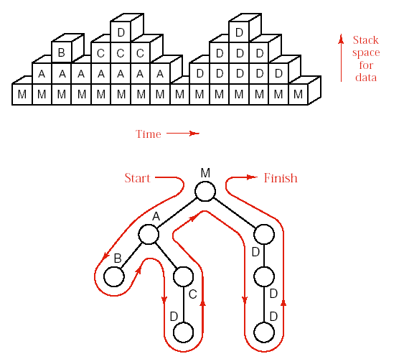

Relation of Function-call and Recursion
Stack frame for function calls
invocation record for Main
Tree of function calls

Slide 6
What is Recursion?
int fun(int n){
if (n<=1)
return n;
return n*fun(n-1);
}
Recursion is the name for the case
  when a function invokes itself （直接递归）
  invokes a sequence of other function, one of which eventually invokes the first function again（间接递归）
int fun1(int n){
if (n<=1)
return n;
return(fun2(n));
}
int fun2(int n){
return (n*fun1(n-1));
}

Slide 7
Some cases of Recursion
定义是递归的，例如：阶乘，表达式；
数据结构是递归的；
问题的解法是递归的，例如：Hanoi问题

Slide 8
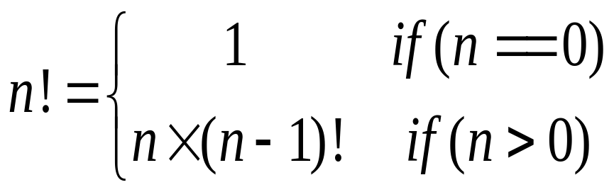
Factorials: A Recursive Definition
factorial(0) = 1;
factorial(n) = n*factorial(n-1);

Slide 9
Computing Factorial
factorial(0) = 1;
factorial(n) = n*factorial(n-1);
factorial(4) = 4 * factorial(3)

Slide 10
Computing Factorial
factorial(0) = 1;
factorial(n) = n*factorial(n-1);
factorial(4) = 4 * factorial(3)
= 4 * 3 * factorial(2)

Slide 11
Computing Factorial
factorial(0) = 1;
factorial(n) = n*factorial(n-1);
factorial(4) = 4 * factorial(3)
= 4 * 3 * factorial(2)
= 4 * 3 * (2 * factorial(1))

Slide 12
Computing Factorial
factorial(0) = 1;
factorial(n) = n*factorial(n-1);
factorial(4) = 4 * factorial(3)
= 4 * 3 * factorial(2)
= 4 * 3 * (2 * factorial(1))
= 4 * 3 * ( 2 * (1 * factorial(0)))

Slide 13
Computing Factorial
factorial(0) = 1;
factorial(n) = n*factorial(n-1);
factorial(4) = 4 * factorial(3)
= 4 * 3 * factorial(2)
= 4 * 3 * (2 * factorial(1))
= 4 * 3 * ( 2 * (1 * factorial(0)))
= 4 * 3 * ( 2 * ( 1 * 1)))

Slide 14
Computing Factorial
factorial(0) = 1;
factorial(n) = n*factorial(n-1);
factorial(4) = 4 * factorial(3)
= 4 * 3 * factorial(2)
= 4 * 3 * (2 * factorial(1))
= 4 * 3 * ( 2 * (1 * factorial(0)))
= 4 * 3 * ( 2 * ( 1 * 1)))
= 4 * 3 * ( 2 * 1)

Slide 15
Computing Factorial
factorial(0) = 1;
factorial(n) = n*factorial(n-1);
factorial(4) = 4 * factorial(3)
= 4 * 3 * factorial(2)
= 4 * 3 * (2 * factorial(1))
= 4 * 3 * ( 2 * (1 * factorial(0)))
= 4 * 3 * ( 2 * ( 1 * 1)))
= 4 * 3 * ( 2 * 1)
= 4 * 3 * 2

Slide 16
Computing Factorial
factorial(0) = 1;
factorial(n) = n*factorial(n-1);
factorial(4) = 4 * factorial(3)
= 4 * 3 * factorial(2)
= 4 * 3 * (2 * factorial(1))
= 4 * 3 * ( 2 * (1 * factorial(0)))
= 4 * 3 * ( 2 * ( 1 * 1)))
= 4 * 3 * ( 2 * 1)
= 4 * 3 * 2
= 4 * 6

Slide 17
Computing Factorial
factorial(0) = 1;
factorial(n) = n*factorial(n-1);
factorial(4) = 4 * factorial(3)
= 4 * 3 * factorial(2)
= 4 * 3 * (2 * factorial(1))
= 4 * 3 * ( 2 * (1 * factorial(0)))
= 4 * 3 * ( 2 * ( 1 * 1)))
= 4 * 3 * ( 2 * 1)
= 4 * 3 * 2
= 4 * 6
= 24

Slide 18


Trace Recursive factorial
Executes factorial(4)

Slide 19
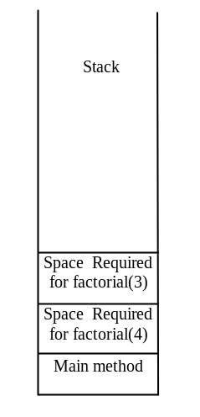
Trace Recursive factorial
Executes factorial(3)

Slide 20
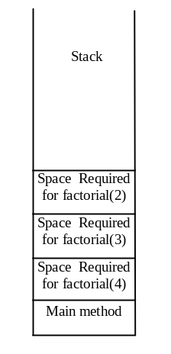
Trace Recursive factorial
Executes factorial(2)

Slide 21
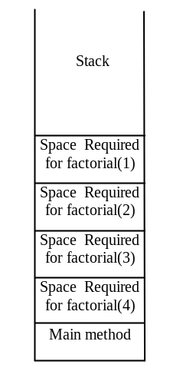
Trace Recursive factorial
Executes factorial(1)

Slide 22
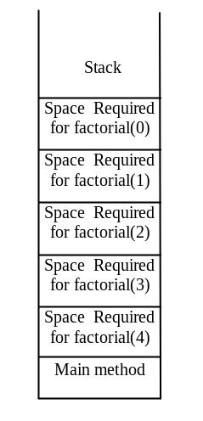
Trace Recursive factorial
Executes factorial(0)

Slide 23
Trace Recursive factorial
returns 1

Slide 24
Trace Recursive factorial
returns factorial(0)

Slide 25
Trace Recursive factorial
returns factorial(1)

Slide 26

Trace Recursive factorial
returns factorial(2)

Slide 27
Trace Recursive factorial
returns factorial(3)

Slide 28
Trace Recursive factorial
returns factorial(4)

Slide 29

factorial(4) Stack Trace

Slide 30
Factorials: A Recursive Definition
Every recursive process consists of two parts:
  A smallest, base case that is processed without recursion;（非递归部分）
  A general method that reduces a particular case to one or more of the smaller cases, thereby making progress toward eventually reducing the problem all the way to the base case.（递归部分）
Programmers must look at the big picture and leave the detailed computations to the computer.

Slide 31
Factorials: A Recursive Definition
Recursion program
int factorial(int n)
{
if (n==0)
return 1;
return n*factorial(n-1);
}

Slide 32
Fibonacci Numbers
Fibonacci series: 0 1 1 2 3 5 8 13 21 34 55 89…
indices: 0 1 2 3 4 5 6 7 8 9 10 11
fib(0) = 0;
fib(1) = 1;
fib(index) = fib(index -1) + fib(index -2); index >=2
fib(3) = fib(2) + fib(1) = (fib(1) + fib(0)) + fib(1) = (1 + 0) +fib(1) = 1 + fib(1) = 1 + 1 = 2

Slide 33

Fibonnaci Numbers, cont.

Slide 34
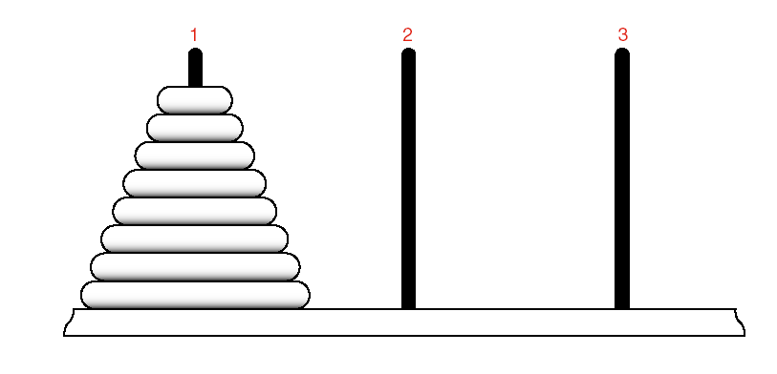

Divide and Conquer: The Towers of Hanoi
The Problem
  move(64,1,3,2)——move 64 disks from tower 1 to tower 3 using tower 2 as temporary storage.
  One disk can be moved at a time and no disk is ever allowed to be placed on top of a smaller disk.

Slide 35
Divide and Conquer: The Towers of Hanoi
分治法
  分治法与软件设计的模块化方法类似——为了解决一个大的问题，将一个规模为n的问题分解为规模较小的子问题，这些子问题互相独立并且和原问题相同。分别解这些子问题，最后将各个子问题的解合并得到原问题的解。
  子问题通常与原问题相似，可以递归地使用分治策略来解决。

Slide 36
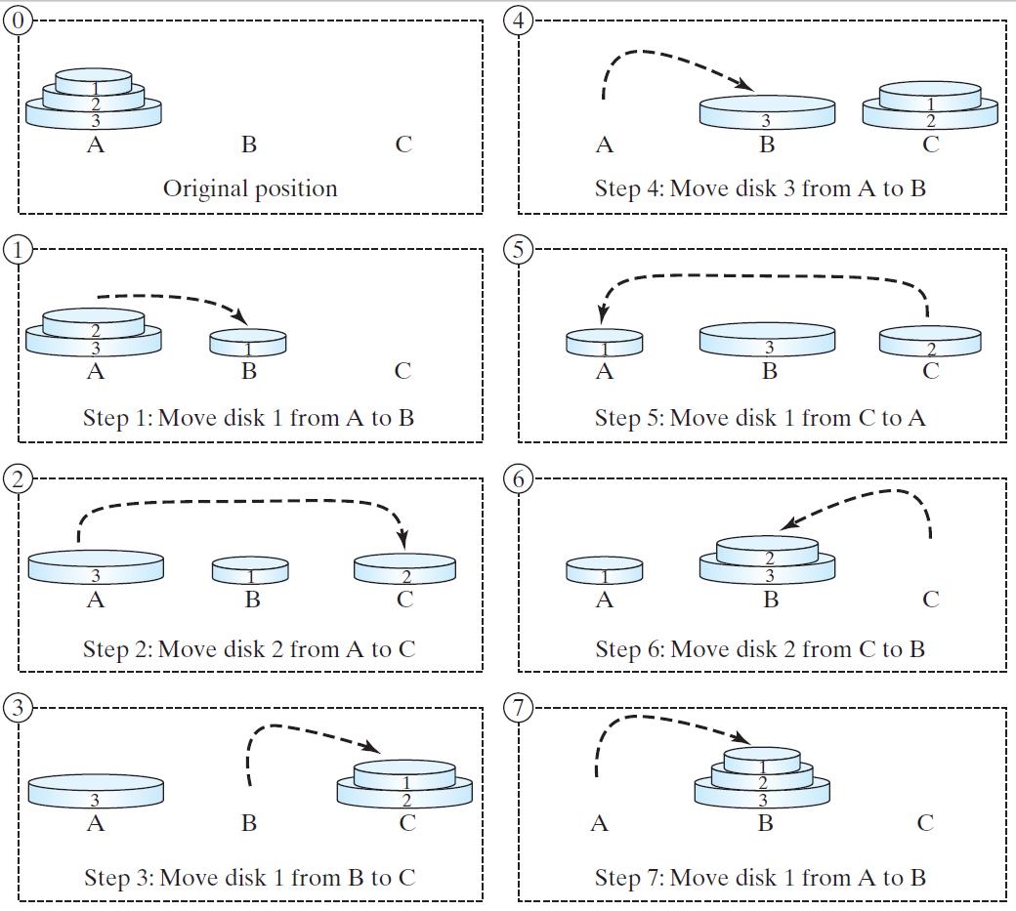
Tower of Hanoi, cont.

Slide 37
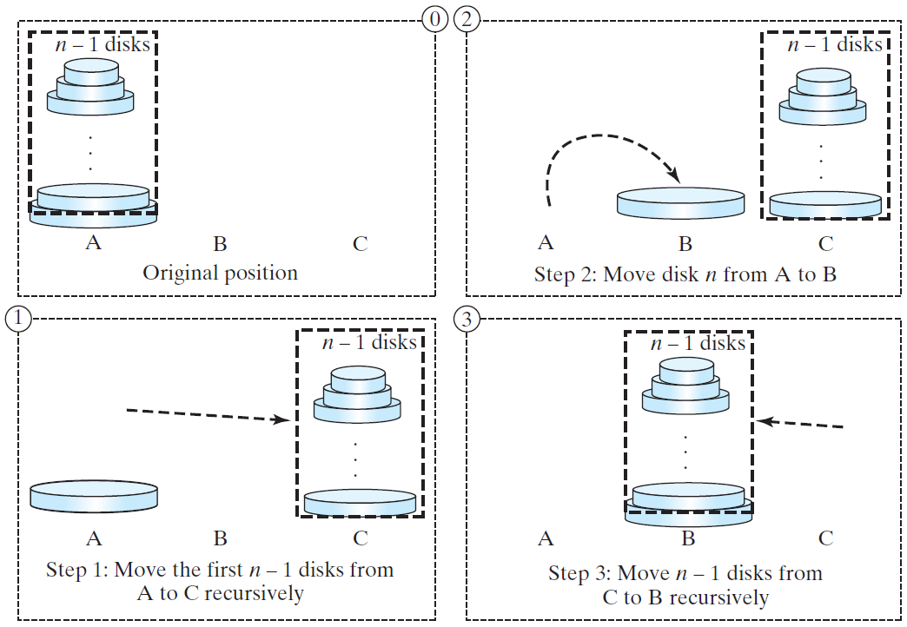
Solution to Tower of Hanoi
The Tower of Hanoi problem can be decomposed into three subproblems.

Slide 38
Solution to Tower of Hanoi
Move the first n - 1 disks from A to C with the assistance of tower B.
Move disk n from A to B.
Move n - 1 disks from C to B with the assistance of tower A.

Slide 39
Divide and Conquer: The Towers of Hanoi
The Solution
  Concentrate our attention not on the first step, but rather on the hardest step: moving the bottom disk.
  //***************************************************//
    move(63,1,2,3); //move 63 disks from tower 1 to 2
    // using tower 3 as temporary storage
    cout<<“Move disk 64 from tower 1 to tower 3.”<<endl;
    move(63,2,3,1); //move 63 disks from tower 2 to 3
    //using tower 1 as temporary storage
  //**************************************************//
  Divide and Conquer: To solve a problem, split the work into smaller and smaller parts, each of which is easier to solve than the original problem.（分而治之）

Slide 40
Divide and Conquer: The Towers of Hanoi
const int disks=64;
void move(int count,int start,int finish,int temp);
main(){
move(disks,1,3,2);
}
void move(int count,int start,int finish,int temp){
if (count>0){
move(count-1,start,temp,finish);
cout<<“Move disk ”<<count<<“ from “<<start<<“ to “<<finish
<<“ . ”<<endl;
move(count-1,temp,finish,start);
}
}

Slide 41
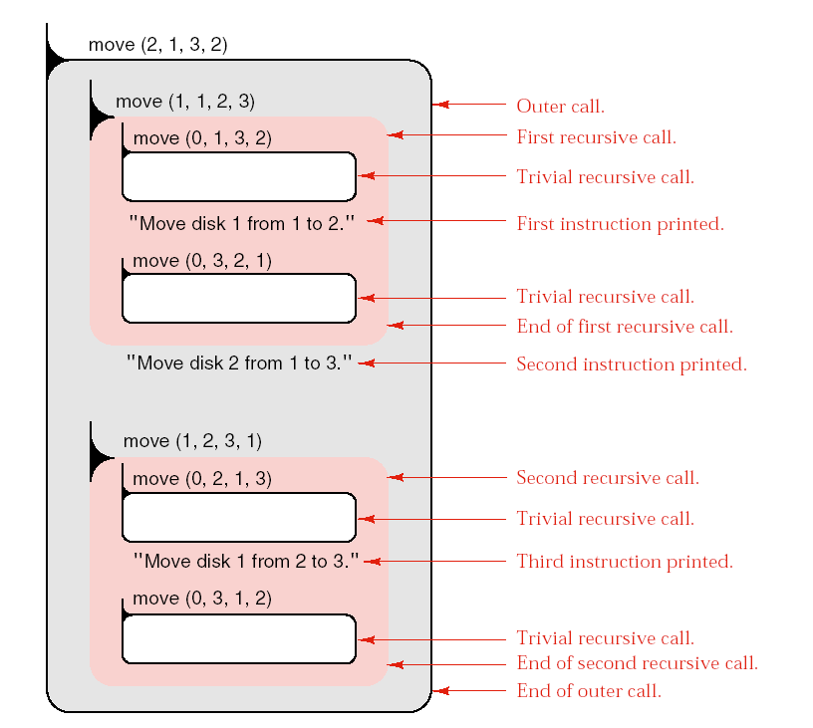
Divide and Conquer: The Towers of Hanoi
Tracing
move(int count,int start,int finish,int temp){
① if (count>0){
② move(count-
1,start,temp,finish);
③cout<<“Move disk ”<<count<<“ from “<<start<<“ to “<<finish <<“ . ”<<endl;
④move(count-1,temp,finish,start);
}
移动次数：3次
Notes:
手工画图

Slide 42
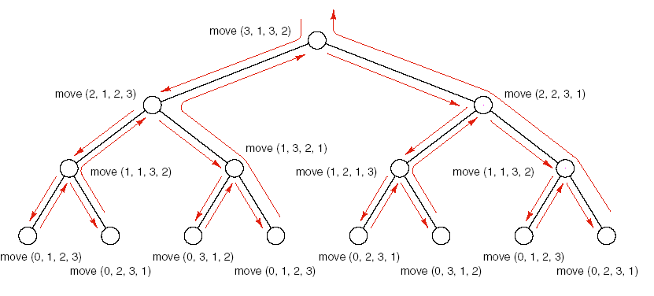
Divide and Conquer: The Towers of Hanoi
Analysis
圆盘移动次数：1+2+4=7次

Slide 43
Divide and Conquer: The Towers of Hanoi
64个圆盘所需搬动次数：2⁰+2¹+2²+……+2⁶³⁼2⁶⁴-1=1.6*10¹⁹次
如每秒一动一次，所需时间：5*10¹¹years
Astronomers estimate the age of the universe at less than (2*10¹⁰)years

Slide 44
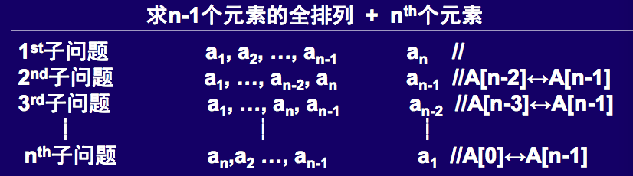
Recursive
有些问题表面上不是递归，但可通过分析，抽象出递归的定义
  例：写一个就地生成n个元素a1,a2,……,an全排列的算法，要求算法终止时保持a1,a2,……,an原状
  题解：a1,a2,……,an存储在数组中，“就地”指不允许使用数组之外的临时存储空间
    生成全排列 n个子问题
    递归终结分支：
      n=1时，一个元素的全排列只有一种，即为本身。

Slide 45
Designing Recursive Algorithms
Important aspects of designing algorithms with recursion
  Find the key step
    How can this problem be divided into parts?
    The remainder of the problem can be done in the same or a similar way.
  Find a stopping rule.
  Outline your algorithm.——combine the stopping rule and the key step, using an if statement to select between them.
  Check termination.
  Draw a recursion tree.---树的高度体现了程序所要求的存储量，树的整个规模体现了所花时间量。

Slide 46
Examples
Error_code stack::maxvalue(Stack_entry &max) const{
return Recursive_ maxvalue(max,count);
}
Error_code stack:: Recursive_ maxvalue(Stack_entry &max, int count){
Stack_entry y;
if (count==0) return not_present;
Stack_entry x=entry[count-1];
if (Recursive_maxvalue(y,count-1)==not_present)
max=x;
else
max=(x>y?x:y);
return success;
}

Slide 47
Examples
int Extended_queue :: size( ) const{
return recursive_size(front);
}
int Extended_queue :: recursive_size(Node *head ) const{
if (head==NULL) return 0;
return 1+recursive_size(head->next);
}

Slide 48
Examples
int Extended_queue :: traverse( ) const{
return recursive_traverse(front);
}
void Extended_queue :: recursive_traverse(Node *head ) const{
if (head!=NULL) {
cout<<head->entry;
recursive_traverse(head->next);
}
}

Slide 49
How Recursion Works
Multiple Processors
  most natural way to think of Implementing recursion is to think of each function running on a separate machine, not each function occupying a different part of the same computer.（每个函数运行在不同的机器上，而不是运行在相同机器的不同部分）
  Processes that take place simultaneously are called concurrent.（并行）

Slide 50

How Recursion Works
Single-Processor Implementation: Storage Areas
  Common function call: When a function is called, it must have a storage area, which used to save the registers, its return address, calling parameters and local variables. As it returns, it will restore them all, and no longer needs anything in its local storage area.（一般函数调用）
  Difference between nonrecursive function and recursive function: （非递归与递归函数调用的区别）
    For a nonrecursive function, the storage area can be one fixed area, permanently reserved, since we know that one call to the function will have returned before another one is finished.
    For a recursive function, the information stored must be preserved until the outer call returns, so an inner call must use a different area for its temporary storage.

Slide 51
递归的内部实现
一段可执行的C++程序代码在内存中分成4个区域
  代码段：包含程序运行时执行的机器指令；
  静态数据区(static)：程序生命周期中一直存在的数据，静态变量；
  堆(heap)：程序运行时动态分配的存储空间，e.g. new/delete
  栈(stack)：函数调用信息
    函数调用时会产生一个活动记录，它一直存于栈中，直至函数调用结束

Slide 52
Re-Entrant Programs
Essentially the same problem of multiple storage areas arises in a quite different context, that of re-entrant programs.
In a large time-sharing system, there may be many users simultaneously using the C++ compiler, the text-editing system, or database software. Such systems programs are quite large, and it would be very wasteful of high-speed memory to keep thirty or forty copies of exactly the same large set of instructions in memory at once, one for each user.
What is often done instead is to write large systems programs like the text editor with the instructions in one area, but the addresses of all variables or other data kept in a separate area.
Then, in the memory of the time-sharing system, there will be only one copy of the instructions, but a separate data area for each user.(1份程序，多份数据)
Notes:
大型分时系统，许多用户同时使用编译器，文本编辑系统，数据库系统。
一份指令，一份程序
多份数据

Slide 53
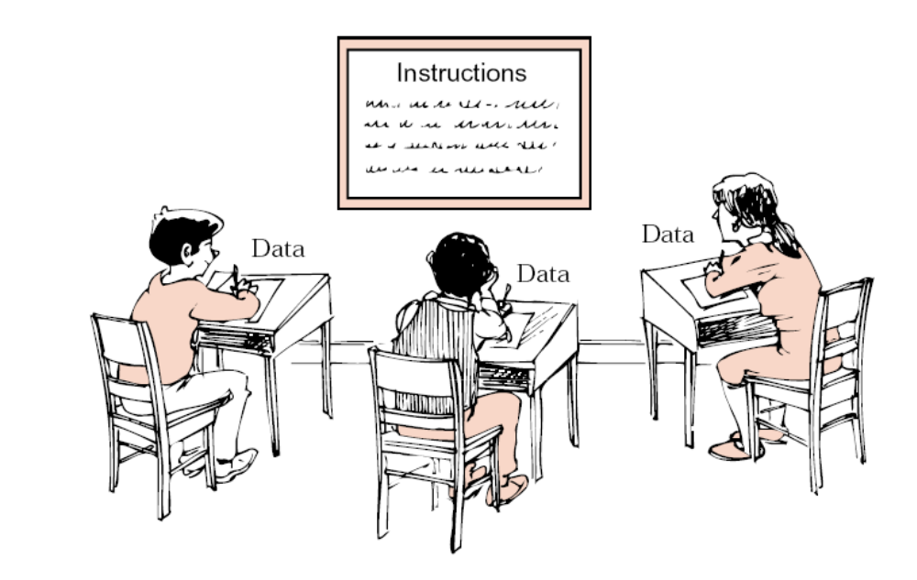

Slide 54
How Recursion Works
Data Structures: Stacks and Trees
  tree of function calls:
    At every point in the tree, we must remember all vertices on the path from the given point back to the root. As we move through the tree, vertices are added to and delete from one end of this path; the other end (root) remains fixed.——vertices on the path form a stack; the storage areas for functions likewise are to be kept as a stack.（将每个函数的活动记录保存为 一个栈。）

Slide 55
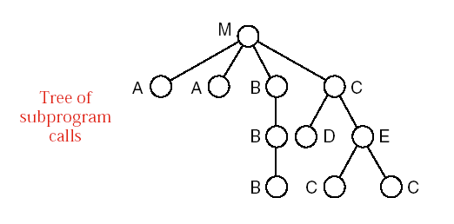
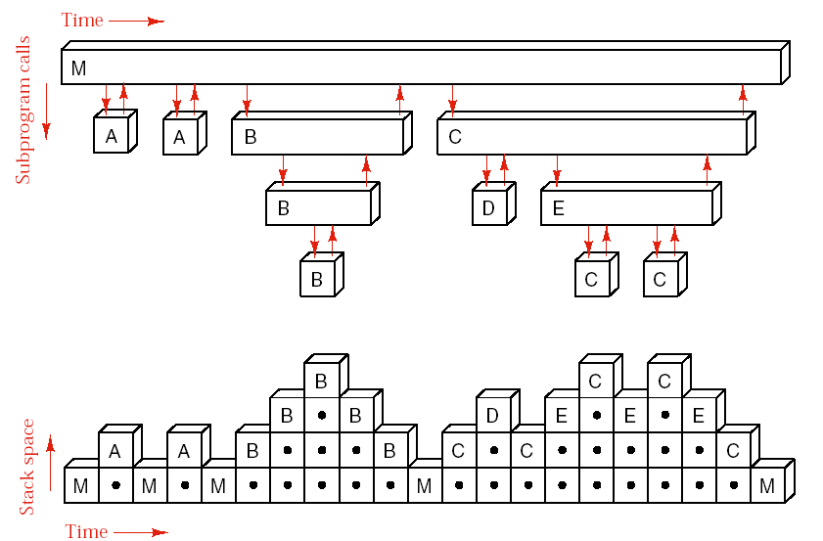
How Recursion Works
Process illustration

Slide 56
How Recursion Works
Data Structures: Stacks and Trees
  The time requirement of the program is related to the number of functions are done, and therefore to the total number of vertices in the tree. （时间需求与调用树中结点数成正比）
  The space requirement is reflected in the height of the tree. （空间需求与树的高度成正比）

Slide 57
Tail Recursion
tail recursion
  A recursive call is the last-executed statement of the function, which is called tail recursion.
  feature of tail recursion （P）:
    since each call by P to itself is its last action, there is no need to maintain the storage areas after returning from the call. (see Figure of the next page)——the calls to P as repeated in iterative fashion on the same level of the diagram.

Slide 58
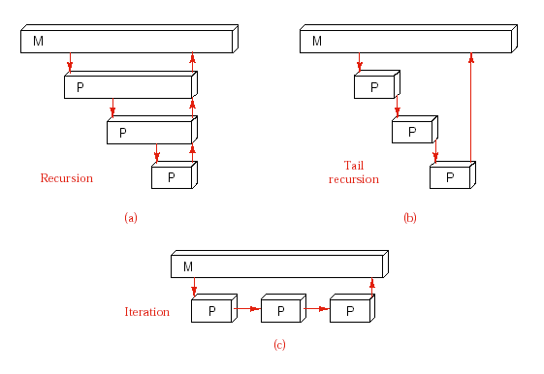
Tail Recursion

Slide 59
Tail Recursion
about tail recursion
  if space considerations are important, tail recursion should often be removed. （空间要求较高时，可以消除尾递归）
  exam: Hanio Tower
    void move(int count,int start,int finish,int temp){
    int swap;
    while (count>0){
    move(count-1,start,temp,finish); //非尾递归，保留
      cout<<“Move disk ”<<count<<“ from “<<start
      <<“ to “<<finish << “. “<< endl;
    count--; //change parameters to mimic the second recursive call.
    swap=start; start=temp; temp=swap;
    }
    }

Slide 60
factorial: recursive version
int factorial(int n)
/* Pre: n is a nonnegative integer.
Post: Return the value of the factorial of n. */
{
if (n == 0) return 1;
else return n * factorial(n − 1);
}

Slide 61
iterative version:
int factorial(int n)
/*Pre: n is a nonnegative integer.
Post: Return the value of the factorial of n. */
{
int count, product = 1;
for (count = 1; count <= n; count++)
product *= count;
return product;
}

Slide 62
the recursive program will set up a stack and fill it with the n numbers
n,n − 1,n − 2,……, 2, 1
as it works its way out of the recursion, multiply these numbers in the same order as does the second program. The progress of execution for the recursive function applied with n = 5 is as follows:
    factorial(5) = 5 * factorial(4)
    = 5 * (4 * factorial(3))
    = 5 * (4 * (3 * factorial(2)))
    = 5 * (4 * (3 * (2 * factorial(1))))
    = 5 * (4 * (3 * (2 * (1 * factorial(0)))))
    = 5 * (4 * (3 * (2 * (1 * 1))))
    = 5 * (4 * (3 * (2 * 1)))
    = 5 * (4 * (3 * 6))
    = 5 * (4 * 6)
    = 5 * 24
    = 120.
Thus the recursive program keeps more storage than the iterative version, and it will take more time as well, since it must store and retrieve all the numbers as well as multiply them.

Slide 63
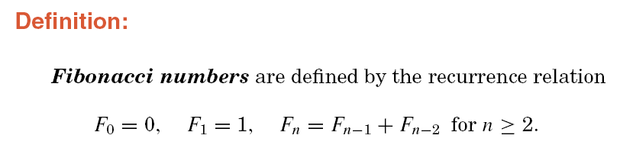
When not to use recursion?

Slide 64
When not to use recursion?
Recursive function
int fibonacci(int n)
/* fibonacci : recursive version
Pre: The parametern is a nonnegative integer.
Post: The function returns then th Fibonacci number. */
{
if (n <= 0) return 0;
else if (n == 1) return 1;
else return fibonacci(n − 1) + fibonacci(n − 2);
}

Slide 65
Nonrecursive function
int fibonacci(int n)
/* fibonacci : iterative version*/
{
int last but one; // second previous Fibonacci number,Fi−2
int last value; // previous Fibonacci number,Fi−1
int current; // current Fibonacci numberFi
if (n <= 0) return 0;
else if (n == 1) return 1;
else {
last_ but_ one = 0;
Last_ value = 1;
for (int i = 2; i <= n; i++) {
current = last_but_one + last_value;
last_but_ one = last_value;
Last_value = current;
}
return current;}
}

Slide 66
递归到非递归的转换
选择递归还是非递归：
  采用递归方式实现问题的算法
    具有结构清晰、可读性好、易于理解等优点
    但空间需求和时间需求都更高
欲节省存储空间，提高执行效率，则考虑使用非递归方式实现算法
  如何进行递归到非递归的转换？
    重新设计——未能利用以后的工作成果
    对给定的递归算法设定一组规则进行等价转换

Slide 67
递归到非递归的转换
简单递归问题：
  在求解过程中直接求值，无需回溯
  可采用递推方法直接求解
复杂递归问题：
  问题求解过程中不能直接求值，必须进行试探和回溯
  借助栈来管理和记忆回溯点

Slide 68
Pointers and Pitfalls
1. Recursion should be used freely in the initial design of algorithms. It is especially appropriate where the main step toward solution consists of reducing a problem to one or more smaller cases.
2. Study several simple examples to see whether or not recursion should be used and how it will work.
3. Attempt to formulate a method that will work more generally.
4. Ask whether the remainder of the problem can be done in the same or a similar way, and modify your method if necessary so that it will be sufficiently general.
5. Find a stopping rule that will indicate that the problem or a suitable part of it is done.

Slide 69
求两个自然数的最大公约数----欧几里得算法
x=90 y=48
x=48 y=42
x=42 y=6
x=6 y=0
最大公约数为6
欧几里得算法
1、输入两个自然数x,y
2、若y=0，则x为最大公约数
3、否则公约数为y和x mod y的公约数.
1、当y！=0时，
temp=x;
x=y;
y=temp%y
2、当y=0时，x为最大公约数

Slide 70
N个数的全排列问题
设计递归算法将十进制正整数转成二进制并输出。
设计递归算法查找长度为n的整型数组中item的位置，找不到返回－1。

